Slide 1

New Parent Companion

Slide 2
Table of Contents
Welcome Letter from our Principal Page 3
New Parent Committee Welcome Letter Page 4
School Contacts and Programs Page 5-7
School Fundraising Programs Page 8
Lunch Program and After-Care Options Page 9
Events Calendar Page 10-11
District School Calendar Page 12
Daily Bell Schedule Page 13
Volunteering Prep & Forms Page 14-17
Community Reference List Page 18-19

Slide 3
Welcome to Daves Avenue!
Daves Avenue Elementary School
17770 Daves Avenue
Monte Sereno, CA 95030
(408) 335-2200
daves.lgusd.org
Dear Cool Cat Students and Families,
Welcome to Daves Avenue Elementary School! I trust that your summer was full of exciting novels, sunshine, and special moments with family and friends. As we embark on the 2019-2020 school year, I am beyond thrilled to be the lead learner of our wonderful school.
Our staff is dedicated to working with students and families to ensure a balanced educational program promoting academic excellence, a love of learning, and resiliency, which ultimately supports our common vision of developing the whole child. With communication, collaboration, critical thinking, and creativity being at the core of daily instruction, our students will master these “Super Skills” needed to navigate and succeed in the 21st Century. In addition to core instruction, our students benefit from a comprehensive program in Character Education, Music, Art, Physical Education, and Technology. This year, LGUSD will be hosting a variety of stakeholder input meetings to devise a new 5-year Strategic Plan. I encourage you to participate! Dates will be announced in the near future.
Our staff takes great pride in providing learning environments where students thrive academically, socially, and emotionally. As your leader, I am committed to bringing our village of stakeholders together including students, parents, staff, and community members. Parents are also encouraged to become Asset Building Champions by getting involved in Project Cornerstone. Your support at home and on campus is invaluable and appreciated!
I know this will be an outstanding year together! If I may be of further assistance to you, please do not hesitate to contact me at jmittleman@lgusd.org or by phone (408) 335-2200.
Sincerely,
Jenna Mittleman, Principal
Daves Avenue Elementary School

Slide 4
New Parent Committee
Welcome to Daves Avenue Elementary School!
We are so happy to have you join the Daves Avenue community. We are proud to be parents at Daves Avenue and delighted you have joined our school!
As the New Parent Committee, we will communicate school activities and coordinate special events for new families. We understand that time is valuable and work schedules vary, so we provide many opportunities for you to engage and collaborate in school activities and special events. All of the activities are highlighted weekly in The Avenue e-newsletter. This e-newsletter is emailed to parents every Wednesday, so keep an eye out for it. We encourage you to visit the Daves Ave School website at daves.lgusd.org where you will find information about the school and teacher websites. We also encourage you to visit the Home & School Club (H&SC) website at davesavehsc.org. The Daves Ave H&SC is our parent volunteer organization that supports our Daves community through a wide variety of programs.
Please feel free to send us an email with any questions. We are excited to begin this journey with you! Your participation and enthusiasm will help guarantee a fantastic year.
Warm regards,
Nicole Reginelli (nreginelli@me.com)
Jeannette Pequignot (jpequignot1@icloud.com)
New Parent Committee

Slide 5


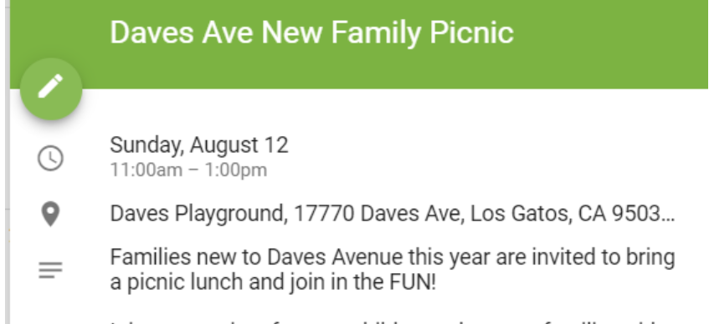



Quick Reference Guide
Contacts & School Programs
Program / Reference | Description | Reference Info
Staff Reference Guide | Teacher and Administration contact information. | daves.lgusd.org/apps/staff/ School Health Clerk: Gigi Harrell –gharrell@lgusd.org
Daves Avenue Attendance Line | If your child will not be attending school, please call the attendance line by 8:45am the day your child will be out. The phone recording will advise what information you need to provide. This line is open 24 hours. | Daves Avenue Attendance Line: 408-335-2245
Daves Event Calendar | Subscribe to the H&SC calendar and you’ll always have the latest details of the many exciting Daves Avenue community events at your fingertips. Google iCal Questions? | H&SC calendar
Daves Home & School Club (H&SC) | Parent volunteer organization that supports our students, teachers and families at Daves through a wide variety of programs unique to our school. | davesavehsc.org
The Avenue | The Avenue e-newsletter is emailed to you every week and has important school-wide information, including school events. This is a great source of information, please read each week. | davesavehsc.org/the-avenue.html
Digital Student Directory | AtoZ Connect is Daves Ave’s online school directory. | Daves Ave H&SC Secretary - secretary@davesavehsc.org

Slide 6



Quick Reference Guide
School Programs
Program | Description | Reference Info
Daves Avenue Green Team | After-school club to foster leadership in school and community activities pertaining to environmental awareness. | davesavehsc.org/green-team.html Committee chair: Stephani Regalia stephaniregalia70@gmail.com
ABC Readers through Project Cornerstone | Parents and Caregivers volunteer in the classroom reading specially selected children’s literature and leading activities and discussions that help develop student life skills. Concepts include: caring, interpersonal competence, personal power, empathy, integrity, equality and social justice, honesty, and responsibility. Training and support is provided for ABC Readers! | davesavehsc.org/project-cornerstone.html Committee chair: Michele Grancell mgrancell@gmail.com Jessie Geis jessica.geis@gmail.com Kinder Chair: Erica Cummings erica.cummings@me.com
FunVisors | Lunchtime program open to all kids grades 1-5 that offers different events each day and gives every kid an activity to enjoy at lunch. | Committee chairs: Michéle Pullens -jhpmic@gmail.com Rachel Ruggiero sparklepartyrentals@gmail.com Christina Rapisura -clrapisura@gmail.com

Slide 7



Quick Reference Guide
School Programs
School Play | Broadway worthy production put on by 4th and 5th graders from all four elementary schools in the district. Auditions start in October, with final performances in early February. | Information will be sent home in the fall and notices posted in The Avenue e-newsletter. Committee chair: Ali Olivo reefandkorasmom@aol.com
Champions of Math | An international program, for 4th and 5th graders only, designed to stimulate enthusiasm for mathematics by teaching different problem-solving skills and a creative approach to finding solutions. Registration begins in September. | Committee chairs: Ben Horwath ben.horwath@gmail.com Weiwei Gu weiweigu@gmail.com
Safe Routes to School | SRTS is a program that encourages students to walk and roll to school – getting to and from school safely while also building community! Year-round education events such as Walk & Roll morning raffles as well as big events like the 4th grade Bike Rodeo, 3rd grade Bike Helmet Safety, and Kinder Pedestrian Safety Training. Suggested biking / walking routes to Daves Avenue. https://www.lgsaferoutes.org/ https://daves.lgusd.org/apps/pages/index.jsp?uREC_ID=314890&type=d&pREC_ID=720983 | Committee chair: Meaghen Foley Spencer meaghen.spencer@gmail.com

Slide 8




Quick Reference Guide
Fundraising Programs
Program | Description | Reference Info
DOLLARS FOR DAVES | The Daves Avenue Home & School Club (H&SC) is a non-profit, parent volunteer organization. Money raised helps close the funding gap keeping important programs and services at our school. These programs are not possible without strong parental support. Please contribute today! CORPORATE MATCHING: Email CorpMatching@DavesAveHSC.org | davesavehsc.org/donate H&SC VP Becky Tanner vp@davesavehsc.org
LGEF (Los Gatos Education Foundation) | LGEF funds much needed teachers and staff in the Los Gatos Union School District to ensure a high-quality education for the children of Los Gatos. LGEF raises funds for programs at all 4 elementary schools and the middle school. CORPORATE MATCHING: doublethedonation.com/lgef | lgef.org/ Daves LGEF Captains: Beth Jackson bethmariejackson@yahoo.com Jessica Johnson jessicakjohnson@mac.com Kristin Owens kristin.owens@gmail.com
 | Raise money for Daves at no cost to you! Programs include: Amazon Smile OHM Connect Office Depot 5% back to schools and more…. | davesavehsc.org/free2me.html Committee Chair: Jaime Girton swtsnta16@gmail.com
Annual Community Sponsorship Program (ACSP) | Program allows local businesses to support the Daves Avenue Home & School Club (H&SC) sponsored events throughout the entire year. | davesavehsc.org/become-a-sponsor.html Committee Chairs: Jen Lambert jen.lambert@me.com Danielle Rooney dr@iqautoworks.com
Free2Me program

Slide 9




Quick Reference Guide
School Lunch & Child Care
Program | Description | Reference Info
School Lunch Program | Lupe Pena - Food Services 408-335-2382 lpena@lgusd.k12.ca.us Monthly menus are available in the office or online https://content-service.sodexomyway.com/media/DAVES%20JAN%20FULL_tcm560-90748.pdf?url=https://losgatossd.sodexomyway.com/ Payments can be left in designated office box or recurring payment account opened online (see right). | Recurring payments: https://family.titank12.com ** Note: you must obtain your ‘student’s number’ from the front office in order to successfully add student to online account **
Child Care Option: Daves Avenue Clubhouse | On-site child care operated by Los Gatos-Saratoga Community Education and Recreation (LGS Recreation). Offers before and after school care + coverage on ½ days and holiday camp offerings. Offers before school and after school care. | lgsrecreation.org/clubhouse/ Phone: 408-335-2223
Child Care Option: Oak Tree | Licensed child care facility offering on-site after-care, conveniently located directly across the street from Daves Avenue School on the property of First Baptist Community Church. Only offers after school care. | oaktreelg.com/ Phone: 408-395-6682

Slide 10

2019 - 2020 H&SC Events
(Aug – Nov)
Sunday, August 11 @ 11am - New Family Picnic (Blacktop)
Wednesday, August 14 @ 4pm - New Parent Orientation (MPR)
Wednesday, August 14 @ 5pm - Ice Cream Social/Class Lists (Blacktop)
Thursday, August 15 @ 8:15am - First Day/Welcome Back Coffee (MPR)
Wednesday, August 28 @ 12pm - Kinder/TK Playdate (Oak Meadow Park)
Thursday, August 29 @ 8:30am - Room Parent/Chair Meeting (MPR)
Thursday, August 29 @ 6pm - Back to School Night (Minimum Day)
Thursday, August 29 @ 8pm - New Family Wine Night (Enoteca)
Monday, September 2 - Labor Day (No School)
Wednesday, September 4 @ 12:30pm - 1st Grade Playdate (Oak Meadow)
Thursday, September 5 @ 8:30am – Project Cornerstone Kickoff Meeting (MPR)
Friday, September 6 @ 8:30am - H&SC Meeting #1 (MPR)
Tuesday, September 10 - Grades of Green Begins
Wednesday, September 11 @ 12:30pm - 2nd Grade Playdate (Oak Meadow)
Saturday, September 14 - Men's Poker Party (Auction Party)
Wednesday, September 18 @ 12:30pm - 3rd Grade Playdate (Oak Meadow)
Thursday, September 19 @ 8:30am - Principal Chat #1 (MPR)
Thursday, September 19 - 4th Grade Bike Rodeo
Saturday, September 21 - Mamma Mia (Auction Party)
Monday, September 23 - 27 - Walk/Roll to School Week
Wednesday, September 25 @ 12:30pm - 4th Grade Playdate (Oak Meadow)
Friday, September 27 @ 5:30pm - Family Movie Night (Field)
Wednesday, October 2 @ 12:30pm - 5th Grade Playdate (Oak Meadow)
Friday, October 4 - Picture Day
Wednesday, October 9 - National Walk to School Day
Friday, October 11 @ 8:30am - H&SC Meeting #2 (MPR)
Saturday, October 12 - Oktoberfest (Auction Party)
Wednesday, October 16 - Fun Run
Wednesday, October 16 - Champions of Math Begins
Wednesday, October 23 - Red Ribbon Week Begins
Wednesday, October 30 - Kindergarten/TK Pedestrian Safety (in class)
Thursday, October 31 @ 8:30am - Halloween Parade
Friday, November 1 @ 8:30am - H&SC Meeting #3 (MPR)
Monday, November 4 - 8 - Conference Week (Minimum Day Schedule Observed)
Monday, November 11 - Veteran’s Day (No School)
Wednesday, November 13 - Scooter to School Day
Monday, November 25 - 29 - Thanksgiving Recess (no school)
*Dates and times might change. Please visit DavesAveHSC.org for information.*

Slide 11
2019 - 2020 H&SC Events
(Dec – Jun)
Wednesday, December 18 - Staff Appreciation Luncheon
Friday, December 20 - January 3 - Winter Recess (no school)
Tuesday, January 14 @ 8:30am - Principal Chat #2
Monday, January 20 - MLK Day (No School)
Wednesday, January 29 @ 8:30am - New Parent Orientation #2
Friday, February 7 @ 8:30am - H&SC Meeting #4 (MPR)
Tuesday, February 11 @ 5pm - Family Bingo Night (MPR)
Wednesday, February 12 - Carpool to School Day
Monday, February 17 - 21 - February Recess (no school)
Monday, March 2 - 6 - Conference Week (Minimum Day Schedule Observed)
Wednesday, March 11 - Crossing Guard Appreciation Day
Friday, March 13 @ 8:30am - H&SC Meeting #5 (MPR)
Tuesday, March 17 @ 5pm - Family Math Night (MPR)
Thursday, March 19 - Mom's Night Out
Thursday, March 26 - Author's Day
Friday, April 3 @ 8:30am - H&SC Meeting #6 (location TBD)
Monday, April 6 - 10 - Spring Recess (no school)
Wednesday, April 22 - Admin Appreciation Day
Thursday, April 23 - Science Fair Night
Saturday, April 25 - Cool Cat Auction
Thursday, May 7 - National Bike to School Day
Wednesday, May 20 - Staff Appreciation Luncheon
Friday, May 29 @ 8:30am - H&SC Meeting #7 (MPR)
Friday, May 29 - Carnival
Tuesday, June 2 - 5th Grade Party
Thursday, June 4 - Last Day of School/ 5th Grade Graduation
*Dates and times might change. Please visit DavesAveHSC.org for information.*

Slide 12
2019/2020 School Calendar

Slide 13
Daily Bell Schedule
Please note: Campus opens to all students at 8:00 A.M.
School Office Hours: 7:30 A.M. – 3:30 P.M.
Kindergarten
Early Bird 8:10 – 11:30
Late Bird 9:30 – 1:30
(Wednesday all Kindergarten 8:10 – 11:30)
Grades 1 – 3
8:15 – 2:33 School Day
Primary Grade Recess 10:10 – 10:30
Primary Grade Lunch 12:00 – 12:40
(Primary Grade Wednesday 8:15 – 12:10)
Grades 4 – 5
8:15 – 2:38 School Day
Upper Grade Recess 10:10 – 10:30
Upper Grade Lunch 12:20 – 1:00
(Upper Grade Wednesday 8:15 – 12:15)

Slide 14
Volunteering Prep
Tuberculosis Test Requirement
To satisfy California Education Code and Health and Safety Codes, all parents/guardians must have a completed adult TB test on file before they may chaperone fieldtrips or volunteer on Daves Avenue campus.
Link to TB Risk Assessment Questionnaire:
To be administered by a licensed health care provider
ctca.org/filelibrary/TB%20Risk%20Assessment_LACounty.pdf
** A copy of the form is also included on pages 14 & 15 of this packet **
Please write-in your child’s name(s) at the top of the form.
Note: Test results are good for 5 years.
Quick & Easy TB Test Reference:
Dr. Elham Louis, DO
1580 S. Winchester Blvd. #202
Campbell, CA 95008
Phone: 408-364-7600

Slide 15
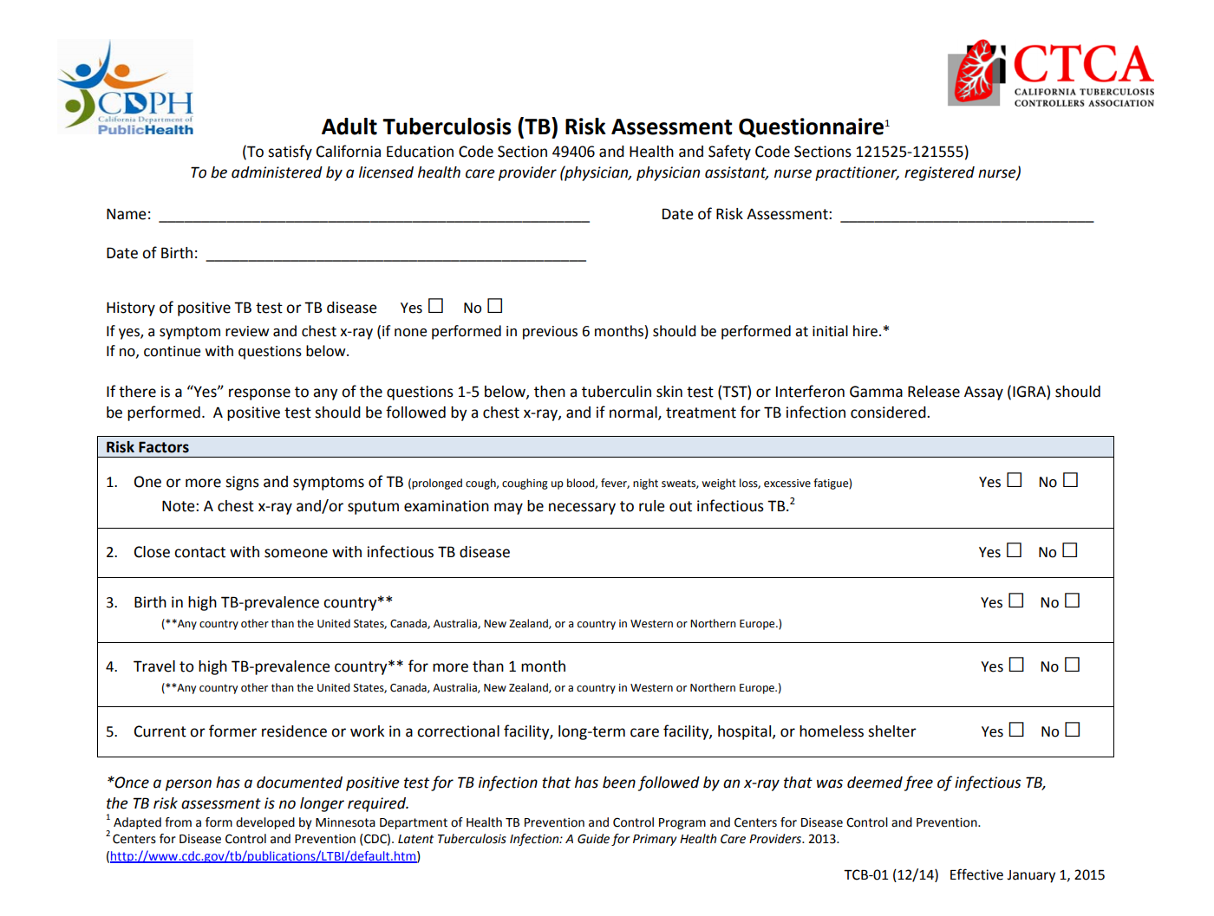
CHILD’S NAME(S): _________________________________________

Slide 16
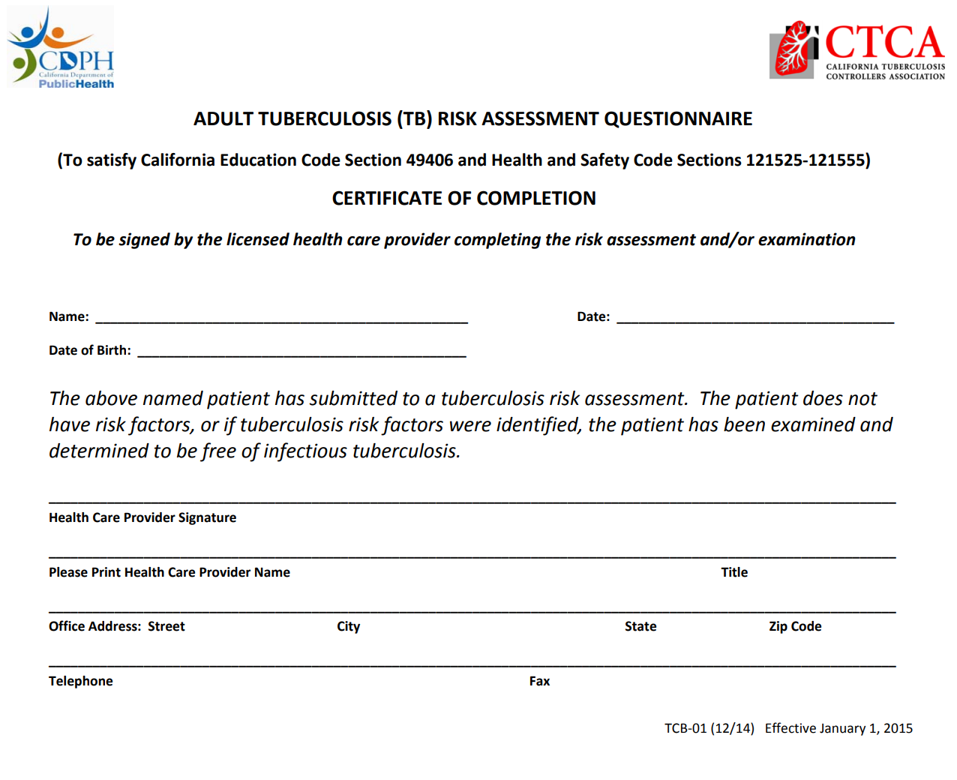

Slide 17
17

Slide 18
Community Reference List
Sports
Soccer Clubs Los Gatos United Soccer League - losgatosunited.com Liverpool Football Club - lfcabayarea.com/ De Anza Force Soccer Club - deanzaforce.org
Baseball Los Gatos Little League - lgll.org
Flag Football Play Flag Football - playflagfootball.com Next Level Sports - nextlevelflag.com/Default.aspx?tabid=311918
Basketball Calvary Basketball League - calvarylg.com/sports/ National Junior Basketball League (NJB) - losgatosnjb.org/
Ice Hockey Sharks Ice Hockey in San Jose - solar4americaiceatsanjose.com Blackhawks Ice Hockey in Fremont - solar4americaiceatfremont.com
Gymnastics West Valley Gymnastics - wvgs.com Airborne Gymnastics - airborne-gymnastics.com
Lacrosse Red Hawks Lacrosse - redhawkslacrosse.org Verve Girls Lacrosse - vervelacrosse.net
Dance The Dance Company of Los Gatos - tdcoflosgatos.com/ Dance Attack - danceattack.com/
Swim Team Stingrays (Los Gatos Swim & Racquet Club) - lgsrc.com/aquatics/swim-team/swim-team-groups/
Volleyball United States Youth Volleyball League - usyvl.org/ Vision Volleyball Club - visionvolleyball.com/
These are just some of many recommendations in the area. The businesses and activities included in this list are in no way endorsed by the school. Please do your own research and background checks when choosing providers and activities for your family.

Slide 19
Community Reference List
Family Health Clubs
Bay Club - bayclubs.com/courtside Los Gatos Swim & Racquet Club - lgsrc.com/
Babysitter Resource
Bambino Sitters (hyper local community app) - bambinoapp.com
Recreation Departments
Los Gatos-Saratoga Community Education & Recreation - lgsrecreation.org/ Saratoga Recreation Programs - saratoga.ca.us Campbell Recreation Center - ci.campbell.ca.us
Parks & Live Event Venues
Los Gatos Parks & Trails - losgatosca.gov/170/Parks-Trails-Locations Mountain Winery - mountainwinery.com Montalvo - montalvoarts.org
Private Neighborhood Social Network
Nextdoor (baby & pet sitters, vendor recommendations, etc.) - nextdoor.com/city/los-gatos--ca/
Doctors / Pediatricians / Urgent Care
Los Olivos Women's Medical Group (OBGYN) - stanfordhealthcare.org/medical-clinics/los-olivos-womens-medical-group.html Sutter Health - sutterhealth.org/find-location/facility/los-gatos-center RAMBLC Pediatric Medical Group (Pediatricians) - ramblc.com Allergy & Asthma - allergycare.com/allergy_asthma_physicians.htm
Dentists / Orthodontists
Dr. Rabitz (Pediatric dentistry) - drrabitz.com Dr. McCleve, DDS - johnmcclevedds.com Dr. Rahimi Dental Group - rahimidds.com Dr. Ellenikiotis (Orthodontics) - dreorthodontics.com/ Dr. Hall & Burnett (Orthodontics) - lgortho.com Dr. Swanson (Orthodontics) - esortho.com
These are just some of many recommendations in the area. The businesses and activities included in this list are in no way endorsed by the school. Please do your own research and background checks when choosing providers and activities for your family.

